Slide 1

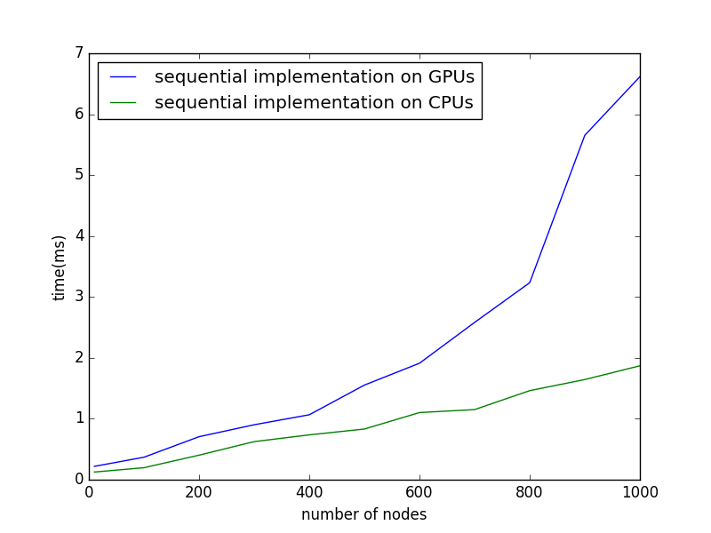
Concurrent AVL Tree Operations on GPUs
Abhishek Yadav
(abhi92914@gmail.com)
IIT Madras
Motivation and Related Work
Abstract
Challenges:
Process of restoring tree invariant becomes bottleneck in concurrent implementations due to mutating operations
Rotations require locks to guarantee the atomicity of their change and keep other mutating operations from affecting the balance conditions of nodes that will be rotated
Concurrent deletion of nodes with both children may lead to locking arbitrary number of nodes
Self-Balancing Binary Search trees support O(h) time search, min, insert, delete, etc. operations where h is the height of the tree
AVL Trees are used to implement interfaces such as map, set etc, which are used in applications that require frequent lookups and updates concurrently.
General Purpose GPUs consist of thousands of cores optimized for parallel processing hence preferable for concurrent operations over multi-core CPUs
Goal is to implement concurrent search and update operations on AVL trees to run on GPGPUs
Concurrent Insert:
Insert process β-locks the node n and checks for insertion
It ξ-locks the father of n to exclude descending processes from accessing n and makes insertion
Uses α-locks in steps, traverses till the root to rebalance the tree
Example
Concurrent Search:
Search operations advance by using self-compatible ρ-locks
Multiple search processes can ρ-lock a node
P2
Deleting node while delete process to its predecessor already locked it for deletion
ϒ-locked
Each node of the AVL tree satisfies height-invariant or balance factor property, i.e. difference between the heights of the left and right subtrees can be at most 1.
Search and update operations are performed the same way as in standard Binary Search Trees except update operations require rotation operations to balance the tree
Update operations traverse up to the root from the place of update and perform one of the rotations wherever required
Single Right Rotation Single Left Rotation
Left-Right Rotation Right-Left Rotation
a
a
Introduction
T1
b
T1
target
b
Concurrent Delete:
Self-incompatible β-locks are used to ensure that a node be deleted by just one delete process
Self-incompatible ϒ-locks are used to lock the node before physically deleting it from the tree and prevents other insert/delete processes from accessing the node
When a node n is ϒ-locked by a delete process which wants to delete its predecessor, n.target is set to point to predecessor node and n is marked invalid
Self-incompatible ξ-locks, incompatible with ρ-locks as well, are used to lock a node n when key of its successor gets copied to it due to delete request to n
ϒ-locked
c
T4
P1
c
T4
P1
TRYING
T3
P1
P2
T3
a
T1
b
a
a
ϒ-locked
c
T4
b
b
P2
T3
b
T4
c
a
T1
b
a
c
Result
References
c
T3
T1
T2
T3
T4
T3
c
T1
T2
T3
T4
Zhang Yin and Xu Zhuoqun. Concurrent Manipulation of Expanded AVL Trees. Journal of Computer Science and Technology, 1998,V13(4): 325-336
Mulralidhar Medidi and Narsingh Deo. Parallel Dictionaries Using AVL Treess. JOURNAL OF PARALLEL AND DISTRIBUTED COMPUTING 49, 146155 (1998) ARTICLE NO. PC981432
Carla Schlatter Ellis. Concurrent Search and Insertion in AVL Trees. IEEE Transactions on Computers, September 1980
Dana Drachsler, Martin Vechev, Eran Yahav. Practical Concurrent Binary Search Trees via Logical Ordering. Proceedings of the 19th ACM SIGPLAN symposium on Principles and practice of parallel programming
Joaquim Gabarró and Xavier Messeguer. A Unified Approach to Concurrent and Parallel Algorithms on Balanced Data Structures. Computer Science Society, 1997 Proceedings.
T1
T2
T3
T4
a
c
a
c
GPU implementation
Performs poorly
b
T4
b
a
T1
b
a
b
T1
c
T1
T2
T3
T4
c
T4
T1
T2
T3
T4
T2
T3
T2
T3

